Slide 1
CSCI-535 Project Final Report
Cross-Modal Synthesis in Multimodal Sentiment Analysis: A Deep Learning Approach for Generating Subjective Expressions
Yaqi Hu, Kshitij Pawar, Zhihao Ma

Slide 2
Problem definition
Main goal: We aim at generating visual emotion expression with speech utterance, image and emotional label as input. Provide alternative feature extraction and collation methods for sentiment analysis.
Alternative goal: We use the CMU-MOSI dataset and the provided features are outdated. We plan to use advanced model like Wave2Vec[3] to extract the audio features. With the new features, we’ll investigate the performance of unimodal and multimodal model.
Objective:
Explore and implement the model generating visual information.
Extract new features for sentiment analysis.
Importance: The generated visual information help increase the accessibility of audio-only resource for hearing impaired population. An emotion label gives less information than generated visual emotion expression..

Slide 3
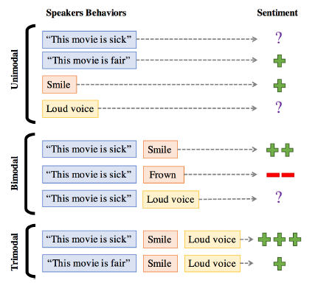
Background
A multimodal sentiment analysis is a task given multimodal data like text, speech or video, the model need to predict the label is positive or negative.
Instead of predicting the label, we aim to give more informative output like video. In some cases, we’re not able to access the video input. It would be meaningful if we can generate the video, which demonstrates the given sentiment label.
Figure.1 Model for sentiment analysis. Credit: Reference [5]
Notes:
Cite: Multimodal Emotion Recognition using Transfer Learning from Speaker Recognition and BERT-based models

Slide 4
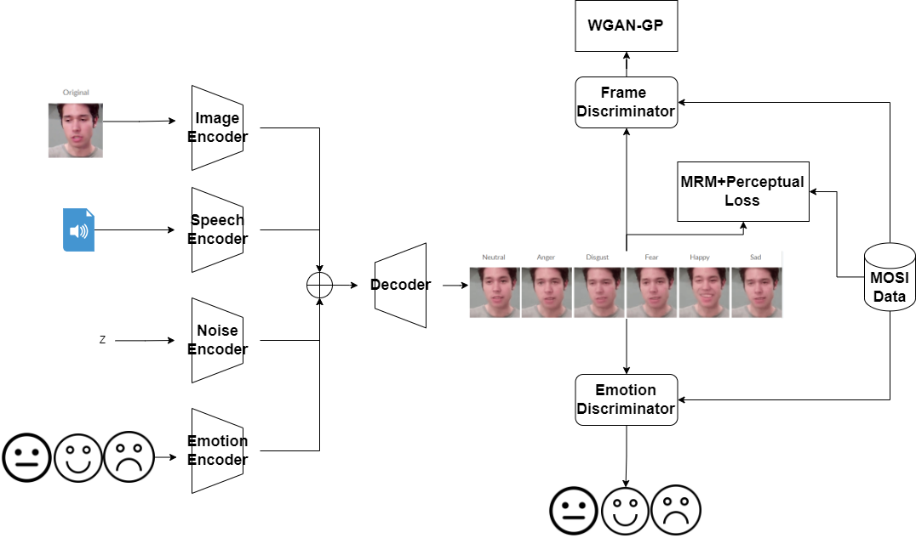
Background
There is a lot of research on generating visual information. As shown in this figure, the research builds four encoders encoding image, speech, emotion label and noise.
Then, another decoder is used to generate video.
The researcher used two discriminators, frame discriminator to detect the quality and emotion discriminator to infer the emotional label.
A new loss is designed to train the encoder, decoder and discriminator simultaneously.
Figure.2 Video Generation pipeline. Image created by us.
Original model Credit: Reference [4]
Notes:
Cite: Deep learning-based multimodal emotion recognition from audio, visual, and text modalities: A systematic review of recent advancements and future prospects

Slide 5
Data
The Multimodal Opinion Sentiment and Emotion Intensity (MOSI) dataset is a comprehensive collection of data aimed at facilitating sentiment and subjectivity analysis in online opinion videos.
2199 video clips in total, with aligned audio and visual data. The videos for the dataset were collected from YouTube, specifically video blogs or vlogs. Each video was manually transcribed, and the text was aligned with audio and visual data.
We extracted the video frames, audio and text description from the raw video. Use them in the later method and results. For each video, we get 227 frames, one audio wav, and one text.

Slide 6
Data
Ryerson Audio-Visual Database of Emotional Speech and Song (RAVDESS) contains 7356 files (total size: 24.8 GB). The database contains 24 professional actors (12 female, 12 male), vocalizing two lexically-matched statements in a neutral North American accent.
We use the speech-only subset of 1440 files for fine-tuning sentiment analysis models.
Speech emotions include calm, happy, sad, angry, fearful, surprise, and disgust

Slide 7
Method
After we extracted the frames and audio wav files from raw video, we tried using pre-trained ViT and Wav2Vec2 for visual and audio data.
Based on that, we first tried augmenting the image/video modality. Using a GAN framework and MRM (Mouth Region Mask) + Perceptual loss, we train a deep learning model on MOSI raw dataset that can generate video frames with audio and emotion modality as input.
Then we try implementing Visual Question Answering as part of Explainable AI effort, as shown before, we make a dataset from the frames files, and using pre-trained ViT and BERT for audio/text.
As part of Sentiment Analysis, we finetune a Wav2Vec2 model using RAVDESS dataset with a custom Classification head and Data Collator.

Slide 8
Result- Unimodal Sentiment Analysis (Audio Modality)
We first tried to fine-tune the wav2vec with audio on the CMU_MOSI dataset, but we only get nearly 0.3 accuracy on it. (With original features, we also get nearly 0.3) We argue that it is caused by the wav in the CMU_MOSI is limited and cannot represent the emotion.
To prove our assumption, we use RAVDESS dataset and fine-tune the model again. From the result, we could say that it proves our hypothesis. The CMU_MOSI dataset is not very good on unimodal especially using the audio data.
Emotion | Angry | Calm | Disgust | Fearful | Happy | Neutral | Sad | Surprised | Accuracy | Macro Avg | Weighted Avg
F1 | 0.90 | 0.88 | 0.88 | 0.87 | 0.74 | 0.76 | 0.78 | 0.86 | 0.84 | 0.83 | 0.84
Support | 38 | 39 | 38 | 39 | 38 | 19 | 38 | 39 | 288 | 288 | 288
Table.1 Audio Unimodal Result on RAVDESS dataset

Slide 9
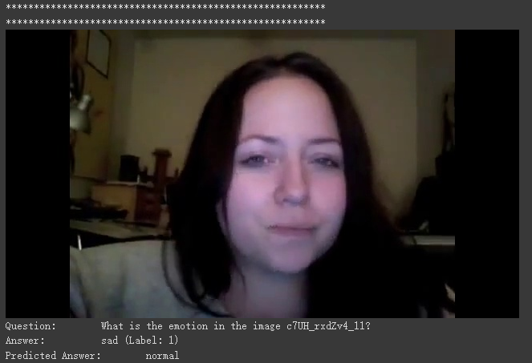
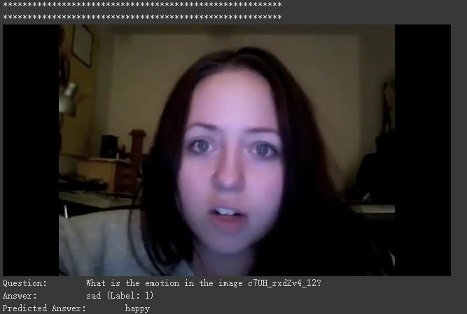
Result - Visual Question Answering
For Visual Question Answering, we collect all the video frame files, select one frame for each video, with its audio, and set each question as: “What is the emotion in the image {number}?” and the answer as normal/sad/happy.
Figure.3 Examples for visual question answering
Notes:
It is a early fusion, ViT for image, and BERT for text. Using early fusion linear layer to fusion them.

Slide 10
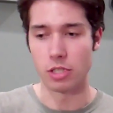






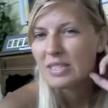






Result - Speech Driven Talking Face Generation
Original
Neutral
Anger
Disgust
Fear
Happy
Sad
Figure.4: Examples for our generated speech - face from one sample image
Notes:
For this, we also use the selected frame for each video, and with their wav

Slide 11
Conclusion
In our project, we first use some baseline models (both unimodal and multimodal) to explore the multimodal sentiment analysis dataset - CMU_MOSI.
After that, we extracted frames, wav files and text descriptions from raw video. By using advanced feature extractor like pre-trained ViT and Wav2Vec2, we do the sentiment analysis again, to show whether we could get better result or not.
We also tried to generate audio by using text and frames, but we get meaningless result. Then we tried some interesting applications, like Visual Question Answering and Speech Driven Talking Face Generation, for which the results have been showcased.
In this project, we have learnt to not set big project goals, but start from getting some basic information, and try some pre-qualified works, rather than built all the thing from scratch.
We also need to have a test demo before we set something as our project idea.

Slide 12
Individual Contribution - After Midterm
Project Contributions:
Yaqi Hu:
- Frame/wav file extraction code writing and test
- Visual Question Answering dataset preparation (w/o labels) processing, debugging and result.
- Speech Driven Talking Face Generation Processing and Result.
Kshitij Pawar:
- Finetuning Wav2Vec2 model for Sentiment Analysis using audio modality
- Unimodal and multimodal sentiment analysis using CMU-Multimodal SDK.
- Visual Question Answering debugging

Slide 13
Individual Contribution - After Midterm
3. Zhihao Ma:
- Using extraction code to extract all frames/wavs for VQA.
- VQA labels creation
- Convert video to FPS and utilize FPS to generate .hdf5 dataset for Speech Talking Face Generation
Slides and presentation:
Zhihao Ma: Problem definition/Background
Kshitij Pawar: Datasets/Method
Yaqi Hu: Method/Results/Conclusion

Slide 14
Reference
[1] V. Sanh, L. Debut, J. Chaumond, T. Wolf DistilBERT, a Distilled Version of BERT: Smaller, Faster, Cheaper and Lighter (2019) arXiv preprint arXiv:1910.01108
[2] Padi, S., Sadjadi, S. O., Manocha, D., & Sriram, R. D. (2022). Multimodal emotion recognition using transfer learning from speaker recognition and bert-based models. arXiv preprint arXiv:2202.08974.
[3] Tsai, Y. H. H., Bai, S., Liang, P. P., Kolter, J. Z., Morency, L. P., & Salakhutdinov, R. (2019, July). Multimodal transformer for unaligned multimodal language sequences. In Proceedings of the conference. Association for Computational Linguistics. Meeting (Vol. 2019, p. 6558). NIH Public Access.
[4] https://github.com/tezansahu/VQA-With-Multimodal-Transformers
[5] https://github.com/eeskimez/emotalkingface?tab=readme-ov-file

Slide 15
Q & A

